Slide 1

Session Timeout Warning Enhancement
November 2016
SPM Technical Infrastructure

Slide 2
Overview
Background
Problem Statement
Problem Statement Examples
Solutions
Proposed Business Solution
Demo Internal Example
Demo External Example
Questions

Slide 3
Problem Statement
Internal Application
The Cúram internal application does not let the user know when the last interaction with the server was made and hence when the application session will time out
This leads to confusion amongst the users of the internal application and could cause eventual loss of data on some of the more complex screens due to the session timing out while the users are still inputting data onto the system
External Application
A session timeout feature has already been implemented in 6.0.5.8
No explanation message displayed on time out

Slide 4
Problem Statement
RTC ticket 107499, “R2 - Introduce a session timer in to the application to let users know when the session will time out”.
Ontario - Minstry Children Youth Svcs (003473)
Singapore, MSF - Singapore (843493)
South Carolina (8531037)

Slide 5
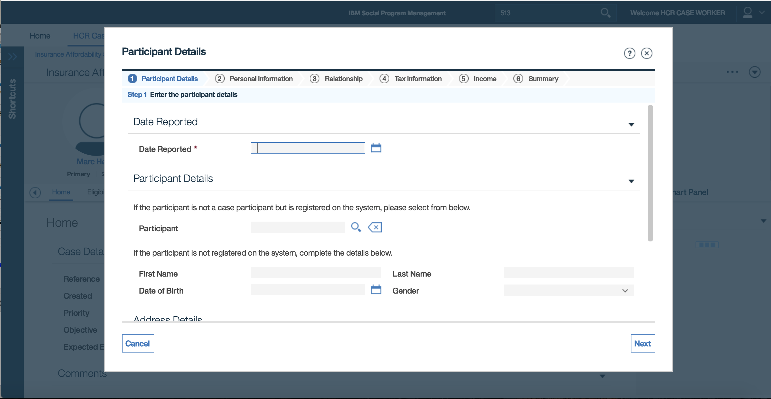
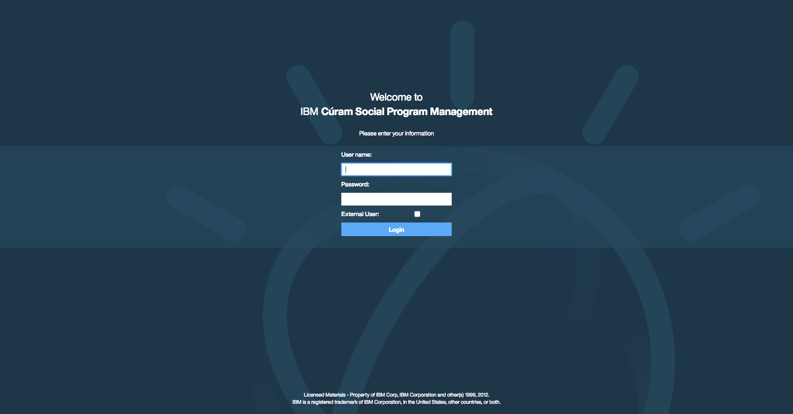

Problem Statement – Internal Application Example
A user taking a long time entering data such as the example shown here when working through the Participant Details wizard will lose this data without any warning when the session times out and is redirected back to the Login page
“What just happened? Where’s all my data gone!?!”

Slide 6
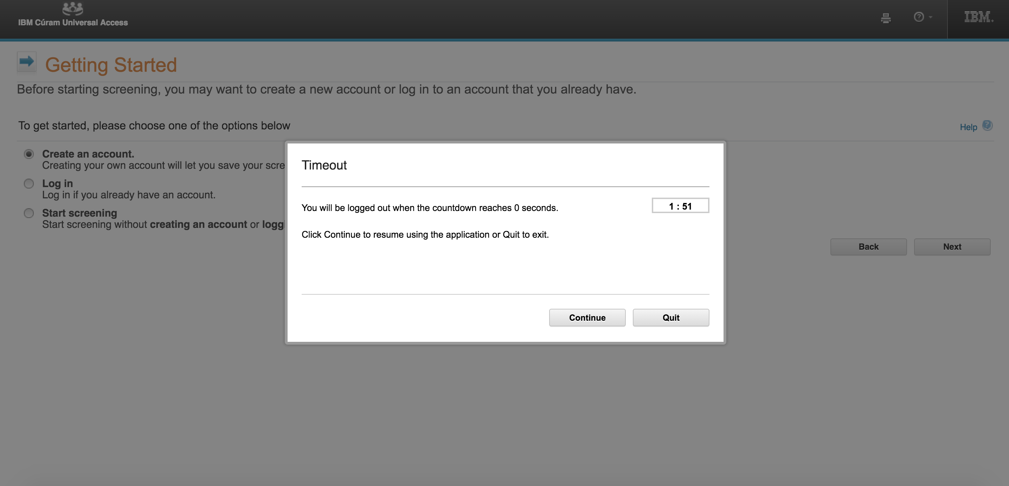
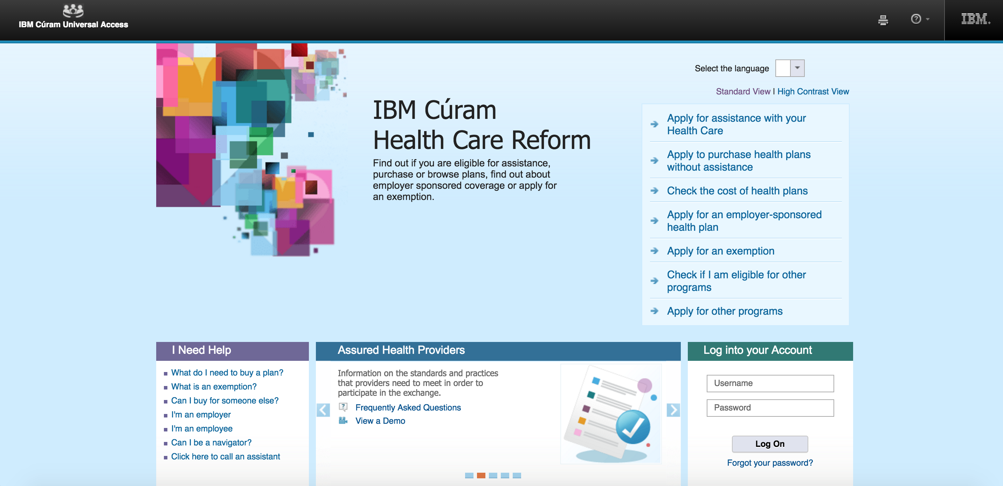
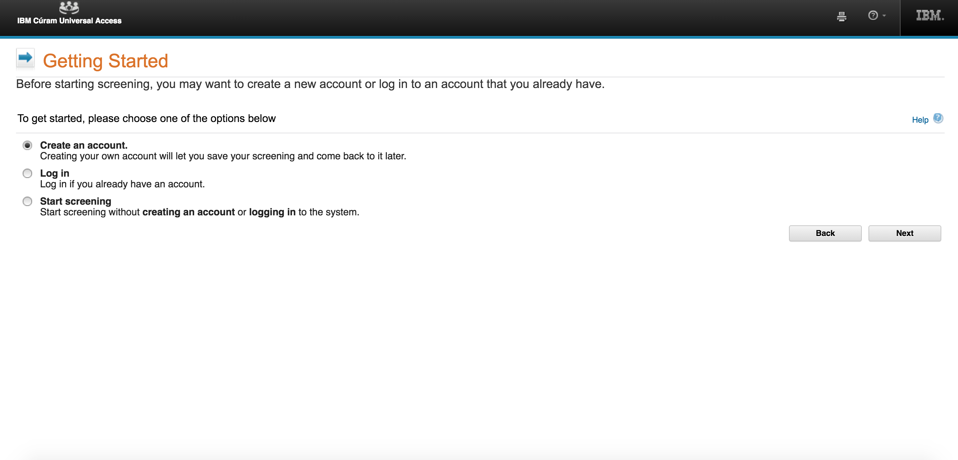
Problem Statement – External Application Example
If the user does not take any action on the Timeout modal they will be auto timed out and redirected back to the Landing page without any further explanation

Slide 7
Proposed Business Solution
Provide a session timeout warning to the user to show when the session is about to expire
Create a single API to execute the session timeout warning for the both the internal and external applications
This feature can be enabled separately for the both the internal and external applications using global system administrator configuration properties
Ability to override some aspects of the default session timeout settings using the configuration file for an application. For example the timeout-warning element within the application configuration(*.app) xml

Slide 8
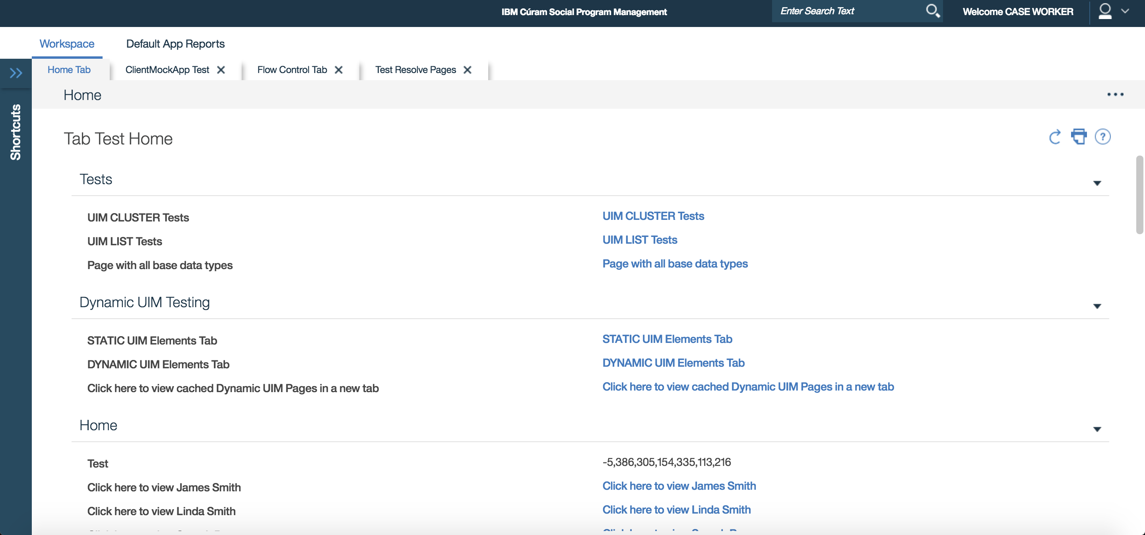
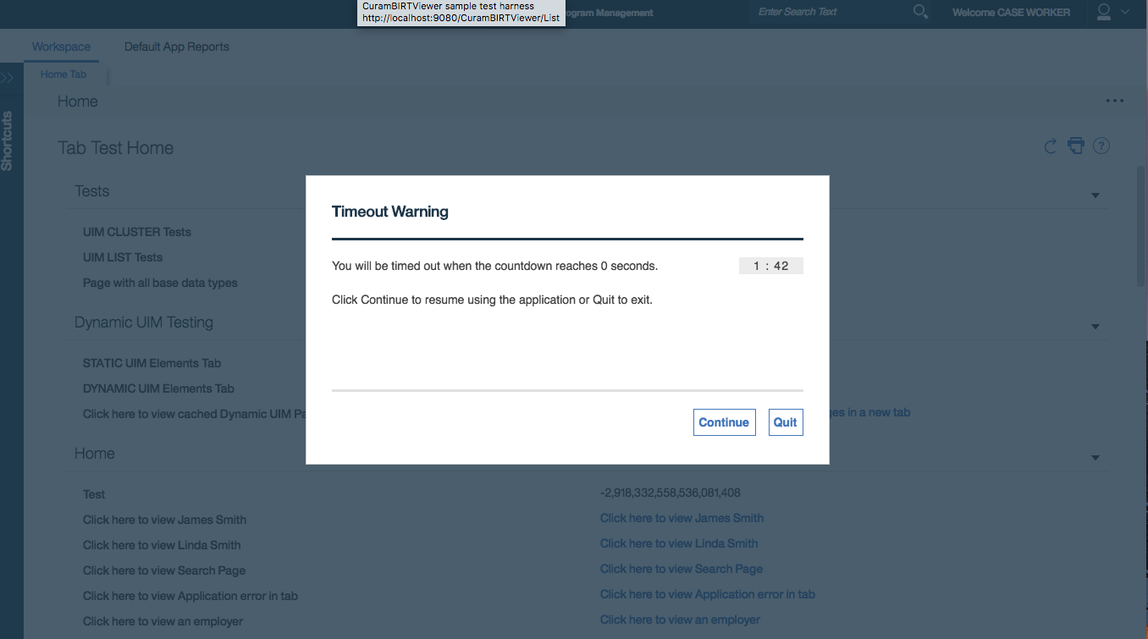

Demo Internal Application

Slide 9
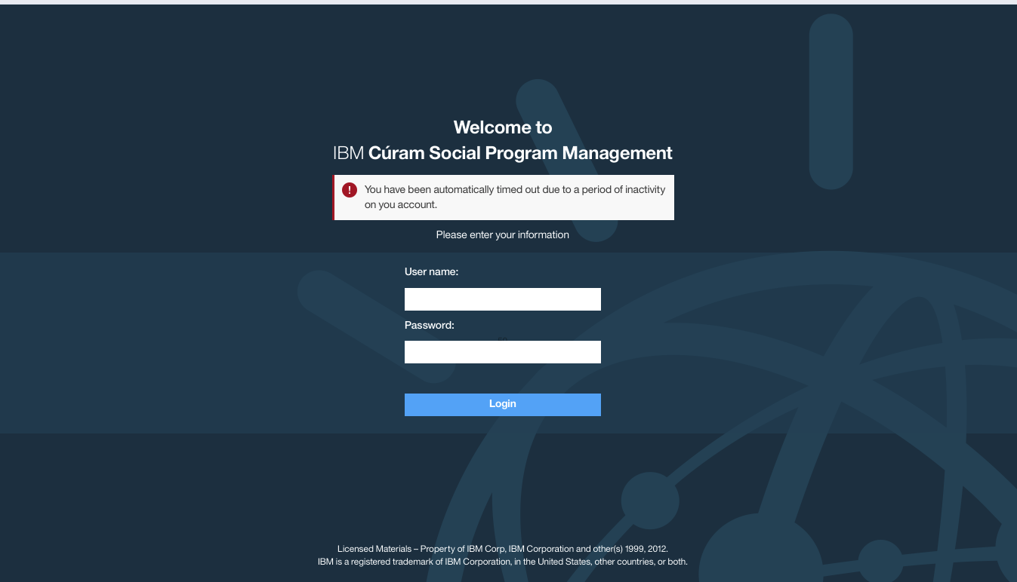
Demo Internal Application – Timed Out

Slide 10
Demo External Application

Slide 11
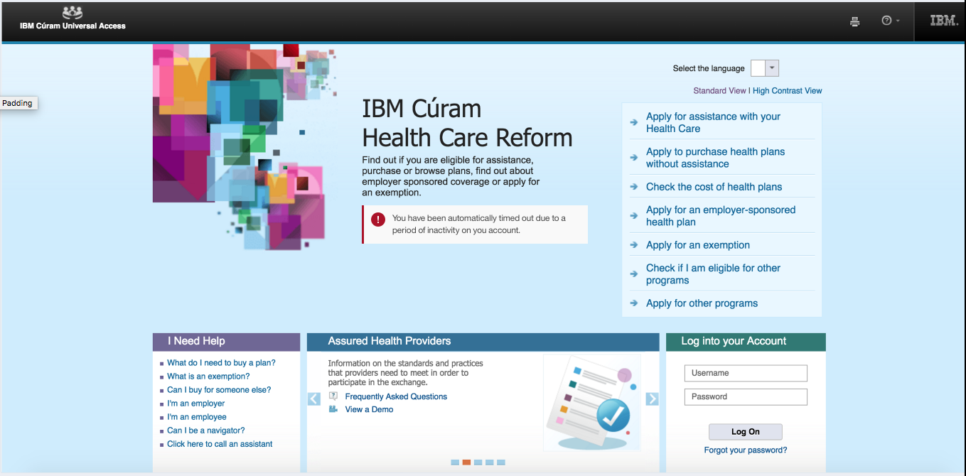
Demo External Application – Timed Out

Slide 12
Technical Overview
Implementation
Implementing Session Timeout Warning infrastructure in CDEJ
Client side details:
TabLayoutResolver class is responsible for getting the properties
JspUtil is used as union point between both application
Logon page is affected inserting scriptlet to show the expired message
The timed out message is stored in the local storage and removed after showing it.
Configuration
By System admin: curam.environment.enable.timeout.warning.modal, curam.environment.timeout.warning.modal.time
By timeout-warning element: title, user-message, expired-user-message, continue-button, quit-button, timeout, width, height
Default values:
ApplicationConfiguration.properties: width, height, buffering-period
CDEJResources.properties: user-message, continue-button, quit-button, dismiss-button
Notes:
Mention that we will be changing the sys admin properties to be able to turn on/off the feature in the internal and external applications separately.
Also change required to make sure the sys admin properties to be able to turn on/off the feature takes precedence over the *.app property settings.

Slide 13
Technical Overview
Configuration table
Property | Default values
curam.environment.enable.timeout.warning.modal | false
curam.environment.timeout.warning.modal.time | 120 seconds
curam.environment.timeout.warning.modal.logoutpage | LogoutWrapper
timeout.warning.modal.width | 617
timeout.warning.modal.height | 264
timeout.warning.modal.title | Timeout Warning
timeout.warning.modal.user.message | You will be timed out when the countdown reaches 0 seconds. Click Continue to resume using the application or Quit to exit.
timeout.warning.modal.continue.button | Continue
timeout.warning.modal.quit.button | Quit
timeout.warning.modal.expired.user.message | You have been automatically timed out due to a period of inactivity on your account.
Notes:
Mention that we will be changing the sys admin properties to be able to turn on/off the feature in the internal and external applications separately.
Also change required to make sure the sys admin properties to be able to turn on/off the feature takes precedence over the *.app property settings.

Slide 14
Delivery Timelines
Area | User Stories | Sprint Delivery | Stack Delivery

Slide 15

QUESTIONS?

